Slide 1
Lab 6 Virtual Memory
CS232 Winter 2021

Slide 3
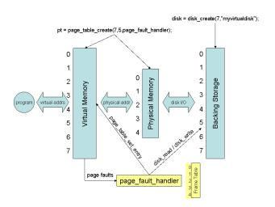

Slide 4
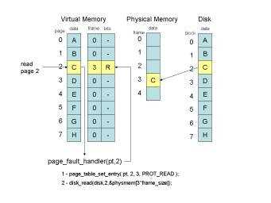

Slide 5
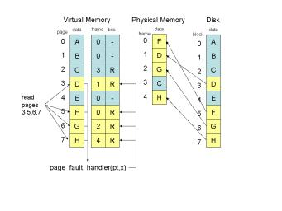

Slide 6
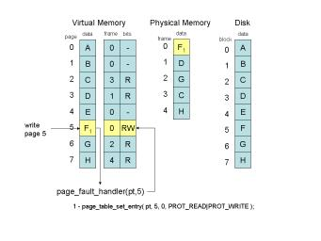

Slide 7
